Slide 1

Measuring the Positive Impact of Generative AI in Nursing Education

Slide 2
A Note on Transparency / Conflict of Interest
handshake
Welcome
We are thrilled to share this presentation with you today.
verified_user
Disclosure & Sponsorship
In the spirit of transparency, please note that this session is sponsored by Unbound Medicine, Inc., and the speaker is a proud employee of the organization, which provides solutions and services related to today's discussion.

Slide 3
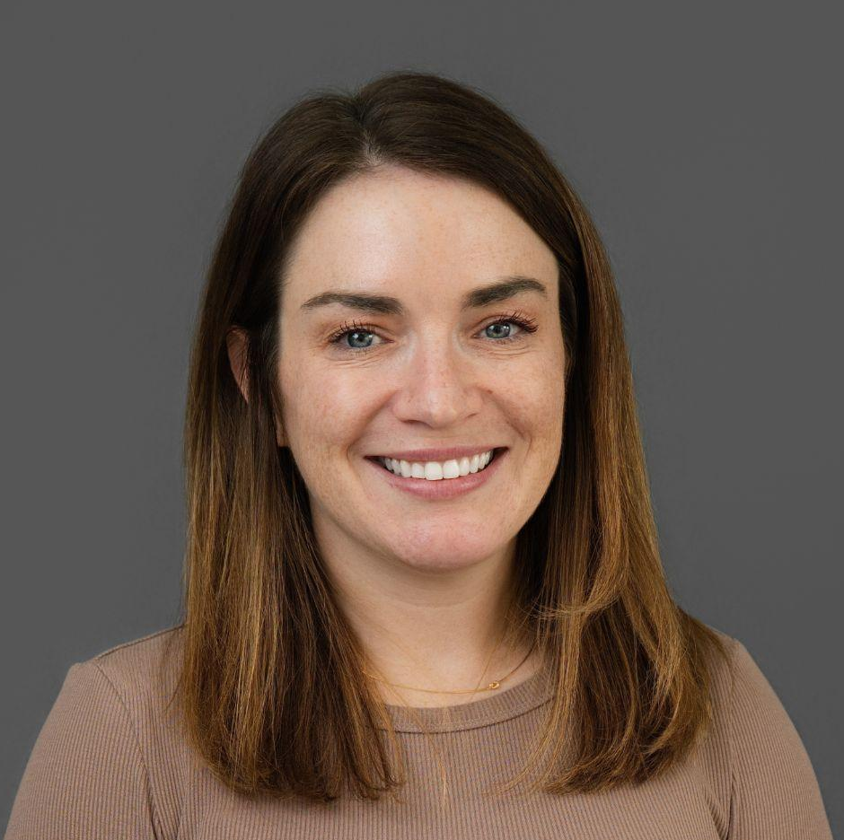
Welcome
Courtney McNulty
Product Manager
Unbound Medicine

Slide 4
Overview
swap_horiz
The Shift
From "Future Possibility" to "Present-Day Variable." Looking at how AI has changed this year alone.
track_changes
The Mission
Reclaiming "Quality Time" for coaching and mentorship.
groups
The Workshop
Why Human-first and last is essential to utilizing Generative AI.
fact_check
The Future
A measured look at faculty and student use cases moving forward.
Notes:
"Welcome, everyone. We’ve all seen the headlines about AI replacing jobs or writing perfect essays. But in Nursing Education, we don’t deal in headlines; we deal in outcomes. The abstract for this session isn't about 'The Magic of AI'—it’s about the measurable impact.
Before we dive into the numbers, I want to address the elephant in the room: Most of us feel like we’re behind. If you feel like a beginner, you’re actually in the super-majority. Today is about moving from 'What is this?' to 'How does this save me four hours a week?' while keeping our students safe. We are here to reclaim our 'quality time'—the time we spend coaching and mentoring, which is the heart of nursing."

Slide 5
The Reality Check: AI Literacy
school
92.8%
Faculty Base
Identify as "Beginner" or "Intermediate."
trending_up
65.1%
Beginner Majority
At the very start of their AI journey.
star
<1%
The "Expert" Myth
Self-rated as "Experts"—we are all pioneers.
flag
#1
Key Priority
Foundational training for institutional acceptance.
Notes:
"Don't be afraid to take that first step, and empower your faculty to do the same." –Scott Dolan, Clark State Dean
"Let’s look at who we are right now. In a recent survey of over 500 of our peers, 92.8% identified as either Beginner or Intermediate. Specifically, 65%—the vast majority—are at the 'Beginner' stage. Not a single person in that group felt like an 'Expert.'

Slide 6
The Efficiency Hook
groups
100%
The Consensus
100% of respondents expect to save at least 1 hour/week.
schedule
38%
Baseline Win
38% expect 1–2 hours of immediate relief.
bolt
42%
High-Impact Win
42% anticipate saving 4+ hours per week.
handshake
Goal
Human Connection
Trading administrative "weight" for human "connection."
Notes:
Why does that matter? It means the 'Foundational Training' we’re discussing today isn't just a suggestion; it’s a requirement. But here is the 'Hook': Even as beginners, the expectations are massive. 100% of respondents expect AI to save them at least an hour a week. And nearly half—42%—anticipate saving four or more hours. Think about that. In a field plagued by burnout, we are looking at a tool that could give us back half a day, every single week. That is the 'Worth It' equation we need to solve."

Slide 7
The Strategic “Why”
schedule
65%
Primary Goal
"Save Myself Time" to reinvest in students.
auto_awesome
61%
Engagement
Creating dynamic, interactive learning experiences.
tune
57%
Personalization
Tailoring content to diverse learner needs.
verified_user
31%
Confidence
AI as a "support system" for student self-efficacy.

Slide 8
The Three Pillars of Best Practice
security
Pillar 01
Safety
Auditing outputs against current clinical guidelines.
verified
Pillar 02
Effectiveness
Ensuring AI-use aligns with course rubrics and objectives.
visibility
Pillar 03
Bias Awareness
Identifying gaps and mitigating bias across AI applications.
Notes:
mission guided by four dynamic and integrated core values Caring, Integrity, Diversity & Inclusion, and Excellence
"When we talk about saving those 4+ hours, we can’t do it at the expense of quality. We use three pillars to measure success:
Safety: 65% of you said your primary goal is 'Saving Time.' But in nursing, time saved is wasted if the clinical guidelines are wrong. We don't just 'use' AI; we audit it.
Effectiveness: 61% of our peers want to increase student engagement. We measure effectiveness by asking: Does this AI-generated case study help the student meet the rubric better than the one I spent three hours writing?
Bias Awareness: AI is a mirror. If the internet has a bias, the AI has a bias. We teach our students to be 'Internal Auditors'—to spot when an AI care plan misses the mark on social determinants of health."

Slide 9
The Workshop
psychology
Part 01
Humans First, Last
Focus on AI as a clinical assistant requiring human intention at the start and validation at the end.
school
Part 02
Literacy Gap
Addressing 92.8% of faculty at beginner or intermediate levels by translating technical jargon into practical workflows.
fact_check
Part 03
CJMM Alignment
Mapping AI exercises directly to NGN Clinical Judgment Measurement Model steps from cue analysis to outcomes.
schedule
Part 04
Time Equity
Saving 1–4 hours per week on drafting to directly fund high-impact student mentoring and clinical coaching.
security
Part 05
Governance
Rules for HIPAA compliance, de-identifying scenarios, and spotting hallucinations or outdated guidelines.

Slide 10
The “Person-in-the-Middle” Framework
admin_panel_settings
Component 01
The Faculty Guardrail
Ensuring AI-to-student pipeline is monitored.
fact_check
Component 02
Augmented
Faculty as the clinical validator.
gavel
Component 03
Boundaries
Identifying when consumer AI is inappropriate for clinical data.
Notes:
"So, how do we actually get those 4 hours back? We use a 'Person-in-the-Middle' framework. Think of a tools from software/resources you use- like Assist in Nursing Central. It’s not an 'Auto-Pilot'; it’s a 'Co-Pilot.'
You—the faculty—are the filter. You prompt the tool, you review the output for clinical accuracy, and you de-identify any data to stay HIPAA compliant. This is how 57% of our peers are planning to provide 'Personalized Learning.' You take the AI’s draft, apply your 20 years of clinical expertise, and deliver a high-quality product to the student in a fraction of the time. We are moving from 'Content Creators' to 'Content Curators.'"

Slide 11
Governance and Roadmap
verified_user
01
Compliance
Navigating FERPA, HIPAA, and proprietary content.
Privacy First: Using de-identified scenarios (Assist in Nursing Central).
gavel
02
Clear Policy
Setting enforceable "Appropriate Use" expectations.
groups
03
The Peer Norm
Scaling confidence through shared prompts and wins.
alt_route
04
Next Steps
Pilots that are transparent, defensible, and continuously improved.
Notes:
"Finally, we have to talk about the guardrails. We want 'Accountable Innovation.' This means clear course policies: Tell your students exactly when they can use AI and when they can’t.
Our roadmap to confidence is built on peer norms. As that 65% of 'Beginners' starts sharing prompts and wins with each other, our literacy rises. We don't need to be computer scientists; we just need to be AI-literate nurses. We’re building a defensible future where AI handles the administrative 'weight' and we handle the human 'connection.'

Slide 12

Bridging the Gap Together

Slide 13
References
Internal Data
Unbound Medicine. (2024). Faculty perspectives on generative AI in nursing education: Survey results and anticipated impact [Internal data set].
Unbound Medicine & OADN Simulation Committee. (2023--2026). Portions of this presentation were developed in conjunction with the OADN Simulation Committee for webinars and workshops focused on the use of AI in nursing education and simulation.
Regulatory & Professional Nursing Standards
American Association of Colleges of Nursing. (2021). The essentials: Core competencies for professional nursing education.https://www.aacnnursing.org/essentials
National League for Nursing. (2025)). Vision statement: Artificial Intelligence (AI) in Nursing Education.https://www.nln.org/docs/default-source/default-document-library/nln_ai_vision_statement.pdf?sfvrsn=dbb7bef_1
National Council of State Boards of Nursing. (2023). NGN news: Clinical judgment measurement model.https://www.nclex.com/clinical-judgment-measurement-model.page
AI Frameworks & Educational Theory
Mollick, E. R., & Mollick, L. (2023). Assigning AI: Seven approaches for students, with prompts. arXiv. https://doi.org/10.48550/arXiv.2306.10052
U.S. Department of Education, Office of Educational Technology. (2023). Artificial intelligence and the future of teaching and learning: Insights and recommendations.https://www.ed.gov/sites/ed/files/documents/ai-report/ai-report.pdf
Ethics, Safety, & Governance
U.S. Department of Health and Human Services. (n.d.). Health Insurance Portability and Accountability Act (HIPAA) privacy rule.https://www.hhs.gov/hipaa/for-professionals/privacy/index.html
World Health Organization. (2024). Ethics and governance of artificial intelligence for health: Guidance on large multi-modal models. https://www.who.int/publications/i/item/9789240084759

Slide 14
For questions and inquiries,
please contact Courtney McNulty
at Unbound Medicine:
cmcnulty@unboundmedicine.com

